Slide 1
K RAMAKRISHNAN COLLEGE OF ENGINEERING DEPARTMENT OF COMPUTER SCIENCE AND ENGINEERING BOOK SHOP MANAGEMENT SYSTEM
PRESENTED BY
PRIYADHARSHINI S
SRUTHI R
USHA B

Slide 2
INTRODUCTION
Book Shop Management System is the computerize application to automate all kinds of activity in book shop.
The task is to build the bookshop management system using JAVA that helps to keep track of all the book records.
The main aim of this project to manage the books in the book store.
This project is very useful for maintain the records of sales and this system keeps all the record of books.

Slide 3
OBJECTIVE
To search records of a book efficiently.
Processing a large amount of data effectively and efficiently.
To provide better service.
It keeps database of book details like book id , book name, price and edition.

Slide 4
FEATURES
Below are the features to be implemented:
Add new book and the details of the book are:
Book ID
Name of book
Edition
Price of book
Delete a book
Update a book
View all the books
Exit

Slide 5
LANGUAGES AND TOOLS
Java
Eclipse IDE
Xampp
MySQL

Slide 6
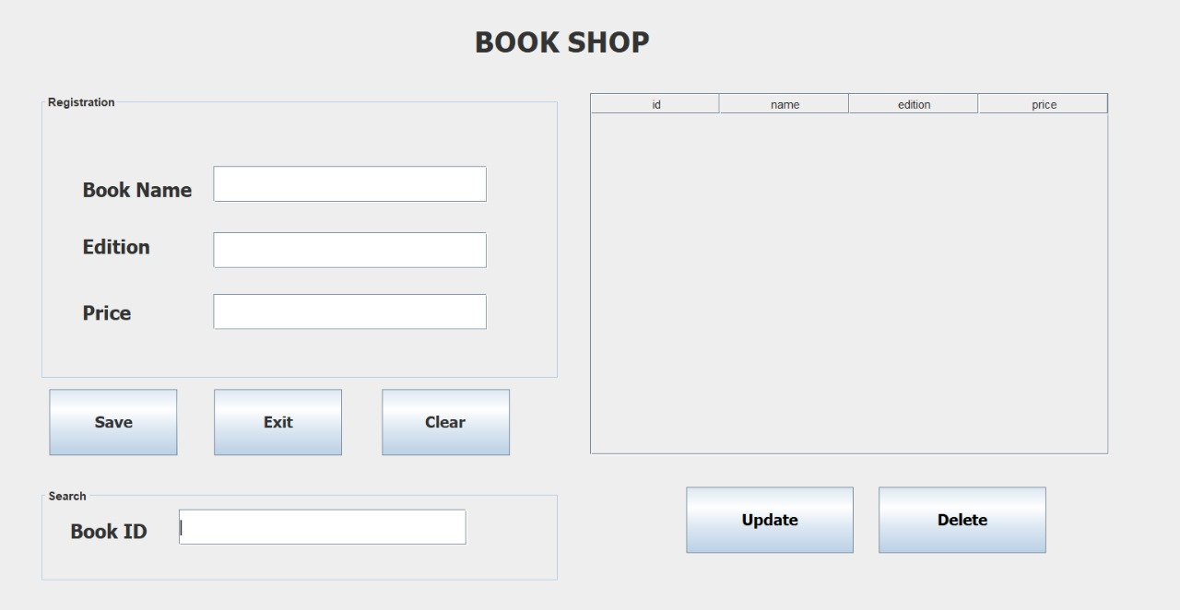
OUTPUT

Slide 7
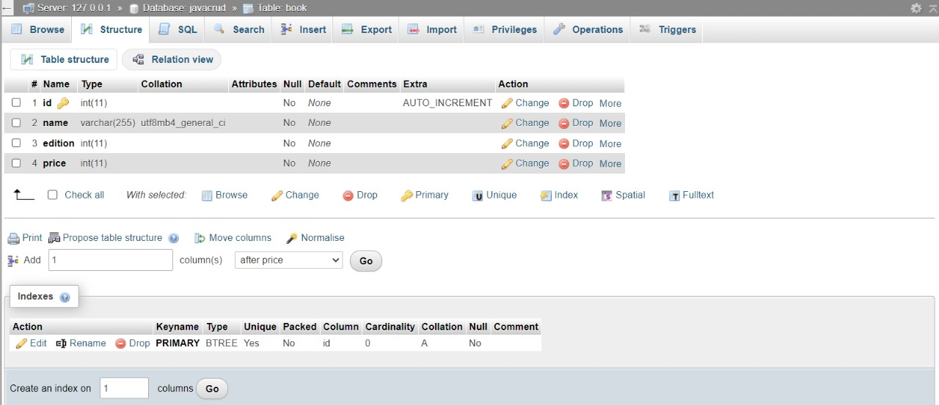
SQL STRUCTURE

Slide 8
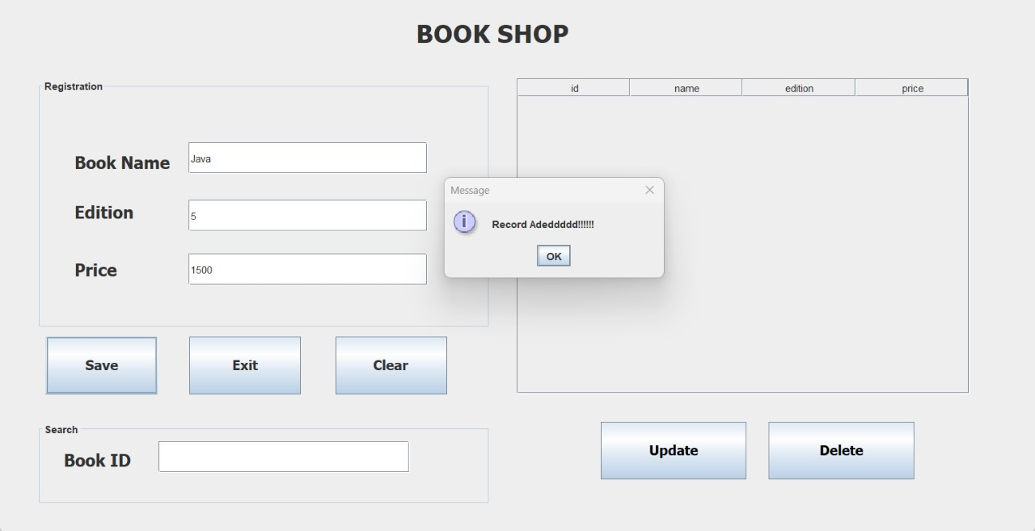
MODULE 1: INSERT THE DATA
In this module the data which we entered will save in the database.
Book id will automatically generate.
It keeps database of book details like
Book Name,
Price
Edition.

Slide 9
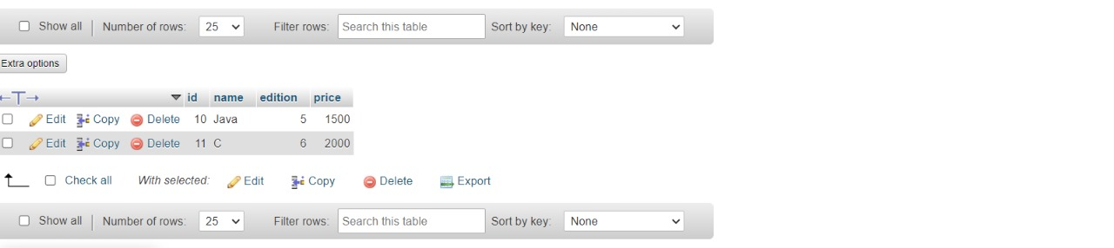
DATABASE

Slide 10

MODULE 2: UPDATE THE DATA
In this module we can search with its book id and we can update any of the book details like book name ,edition and price.
It will also update in the database.

Slide 11
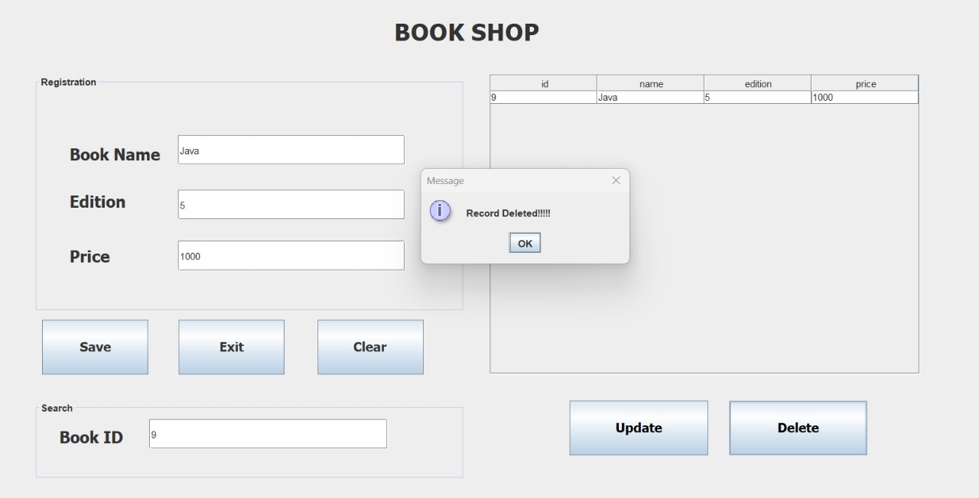
MODULE 3:DELETE THE DATA
In this module we can delete the data by searching with its book id.
It will also gets deleted in the database permanently.

Slide 12
THANK YOU

